Slide 1
The New Testament Church
(Part 5)
Matthew 16:13-18

Slide 2
The New Testament Church
Founded upon Jesus Christ, the Son of God. Matthew 16:18; 1 Corinthians 3:11;
1 Corinthians. 2:2
Began in Jerusalem about 33 A.D.
Isaiah 2:3; Matthew 3:2; Matthew 4:17; Mark 1:14-15; Luke 10:9; Matthew 10:7; Mark 9:1; Luke 24:44ff; Acts 1:6-8;
2:1-4,47; 11:15
Christ is its head and only source of authority. Matthew 28:19;
Ephesians 1:22-23; Matthew 21:23-27; Matthew 7:21; Luke 6:46

Slide 3
The New Testament Church
Organized after the divine pattern.
Philippians 1:1
  Elders: Acts 14:23; 20:28; 1 Peter 5:1ff;
  1 Timothy 3:1-7; Titus 1:5-7
  Deacons: 1 Timothy 3:8-13
  Members: 1 Corinthians 12:12ff

Slide 4
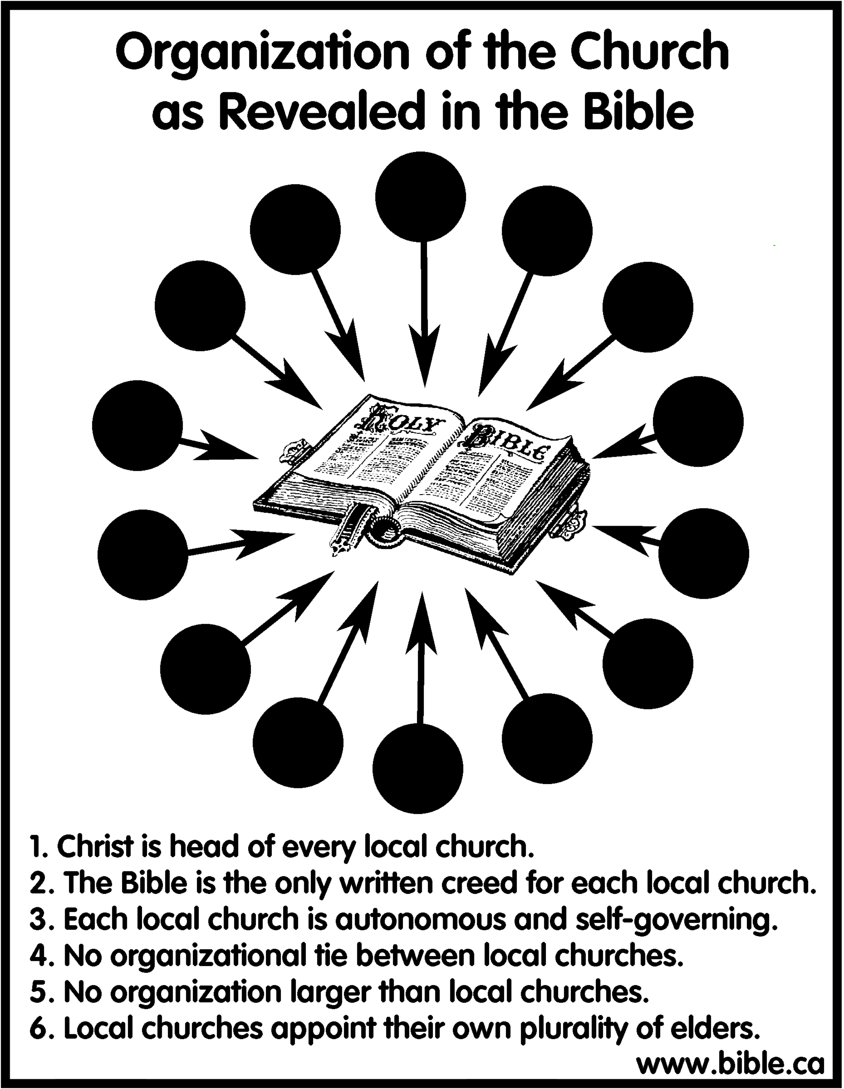

Slide 5
Elders, Bishops, And Pastors
Clearly “elders,” “overseers,” “pastors,” and “bishops” in these passages are used interchangeably, referring to the same men in the same work.
All three terms refer to an office in the local congregation, and are therefore identical in extent of jurisdiction (cf. Acts 20:17, 28; 1 Peter 5:1-3; etc.). Their qualifications and works are identical.
It is a perversion in organization for denominations to distinguish the terms and apply them to different offices.

Slide 6
The New Testament Church
Has a divine mission.
  Evangelism. 1 Timothy 3:15;
  Acts 11:22; Philippians 1:3-5; 4:14-16;
  2 Corinthians 11:8-9
  Benevolence. Acts 2, 4, 6;
  Acts 11:27-30; 1 Corinthians 16:1-3;
  2 Corinthians 8:1-5; 9:1-2;
  Romans 15:25ff
  Edification. Ephesians 4:11-16

Slide 7
Bible Pattern For The Work Of Evangelism
1 Timothy 3:15; 1 Corinthians 9:14; Acts 11:22; Philippians 4:15; 2 Corinthians 11:8-9.
This: Not This:
Church
preacher
Church
Missionary
Society
Or
Sponsoring
Church
Church
Church
preacher
preacher
Church
Church
Church

Slide 8
Bible Pattern For The Work Of Benevolence
This:
Not This:
Acts 2, 4 ,6
Acts 11:27-30
Reason for giving:
“that there might be equality”
2 Corinthians 8:14
1 Corinthians 16:1-3
2 Corinthian 8-9
Romans 15:25ff

Slide 9
Bible Pattern For The Work Of Edification
Place
Personnel
Provisions
Ephesians 4:11-16

Slide 10
The Lord’s Church Is Not …
A Political Force. John 18:33-38
A Business Organization. 1 Corinthians 16:1-2;
2 Corinthians 9:7
A Secular School. 1 Corinthians 1:20-21
A Social Center. Romans 14:17;
1 Corinthians 11:22-34

Slide 11
The New Testament Church
No creed but the Bible.
  Gospel – God’s power to save. Romans 1:16
Complete will of God. 2 Peter 1:3
  Promised. John 14:26; 15:26; 16:13
  Inspired. 2 Timothy 3:16-17
  Spirit revealed. Ephesians 3:6;
  1 Corinthians 2:6-16; 1 Peter 1:12
  May not add to or change. Galatians 1:6-9;
  2 John 9
  Understandable. Ephesians 3:3-4
  Once for all delivered. Jude 3

Slide 12
The New Testament Church
Scriptural in name.
  “The church of God” 1 Corinthians 1:2;
  1 Timothy 3:15
  “The body of Christ” Ephesians 1:22-23
  “Bride of Christ” Romans 7:4; Revelation 21:9
  “Church of the firstborn” Hebrews 12:23
  “House of God” 1 Timothy 3:15
  “Churches of Christ” Romans 16:16

Slide 13
The New Testament Church
Members called by Scriptural names:
  Disciples. John 15:8; Acts 11:26
  Saints. Romans 1:7; 1 Corinthians 1:2; Philippians 1:1
  Brethren. Luke 8:21; Galatians 6:1
  Children. Galatians 3:26; 1 John 2:1
  Christians. Isaiah 62:2; Acts 11:26; 26:28;
  1 Peter 4:16
Is Christ divided? Was Paul crucified for you? Were you baptized in the name of Paul? 1 Corinthians 1:12-13

